Slide 1

CSC 533: Privacy in the Digital Age (Fall 2020) Lecture 22: Modeling Users’ Privacy Preferences
Anupam Das
Nov. 03, 2020

Slide 2
Goals
Ways to help users make better privacy decisions (preferences)
Ways in which ML can help users configure their privacy preferences
Privacy preferences in IoT
Some slide content taken from Norman Sadeh, W. He, P. E. Naeini

Slide 3
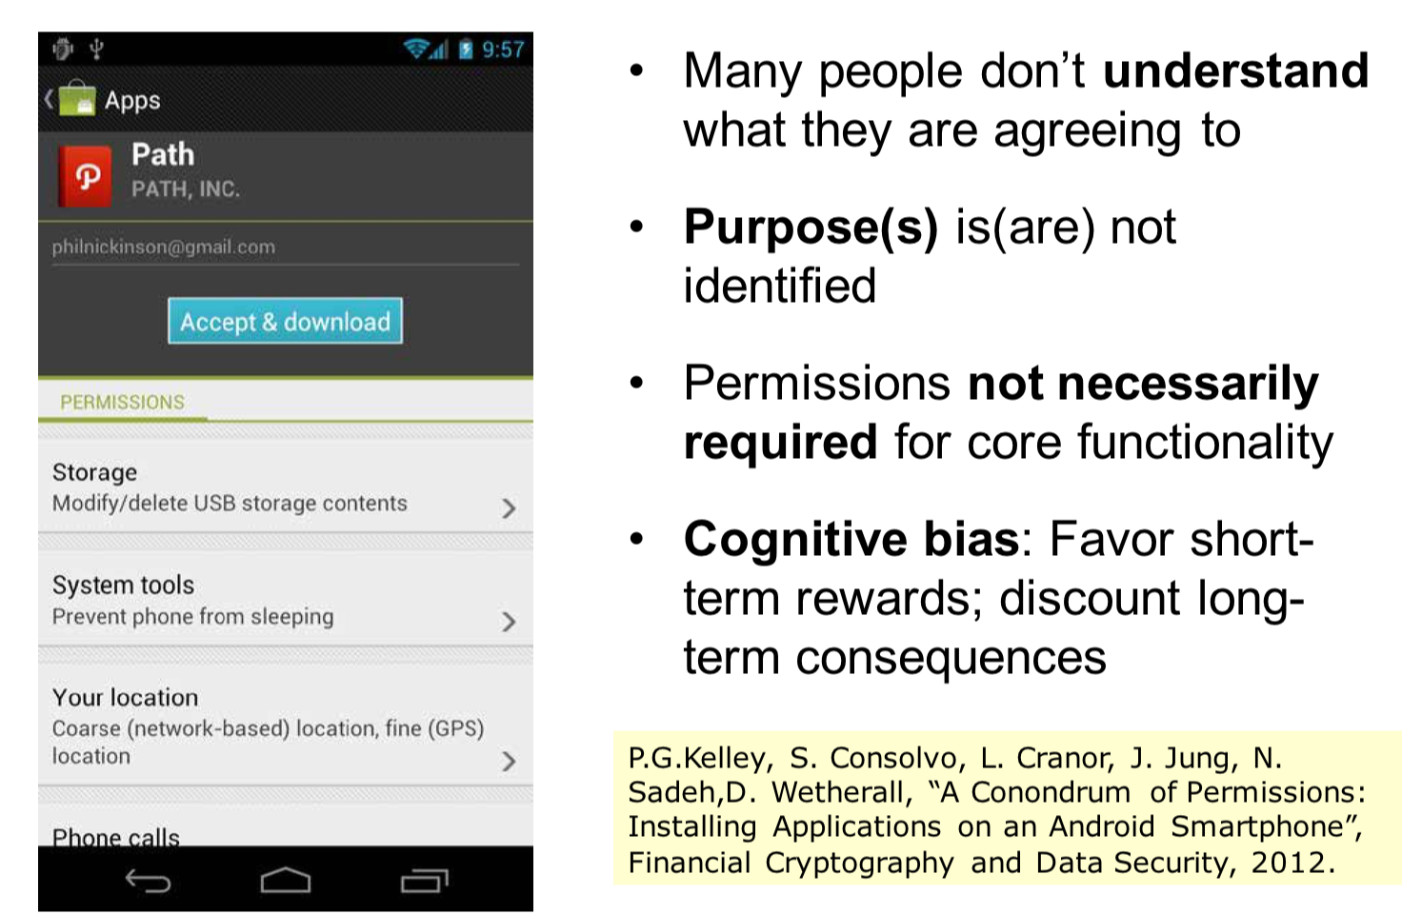
Users are not good at making decision

Slide 4
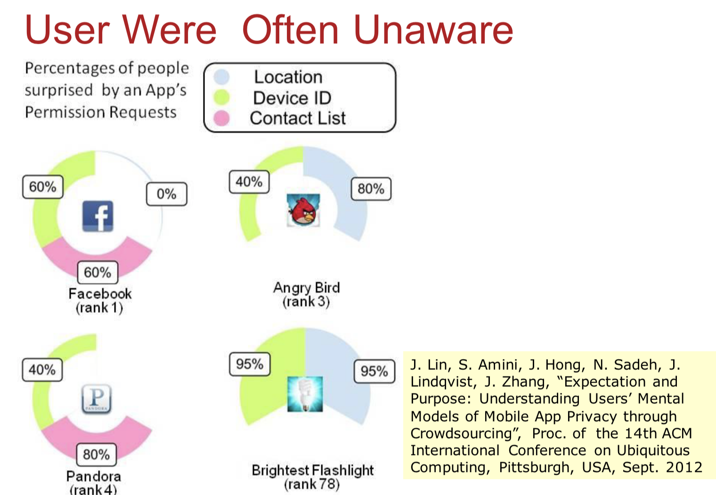
Users are not aware of permissions

Slide 5
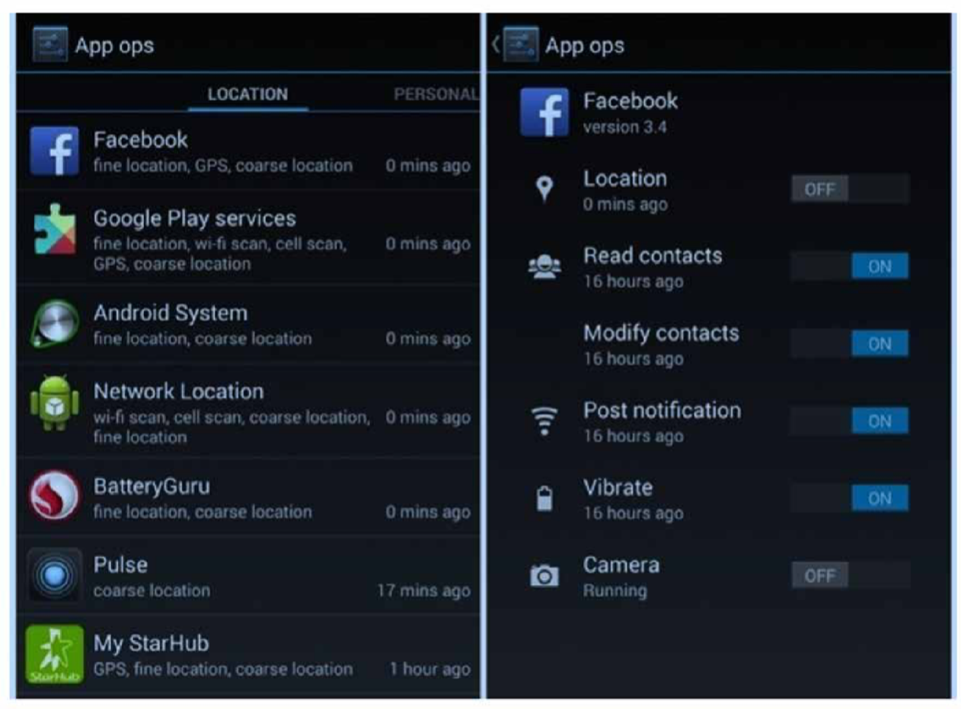
Luckily we have permission managers
Enable us to view what apps access what permission
Allows us to also update permissions

Slide 6
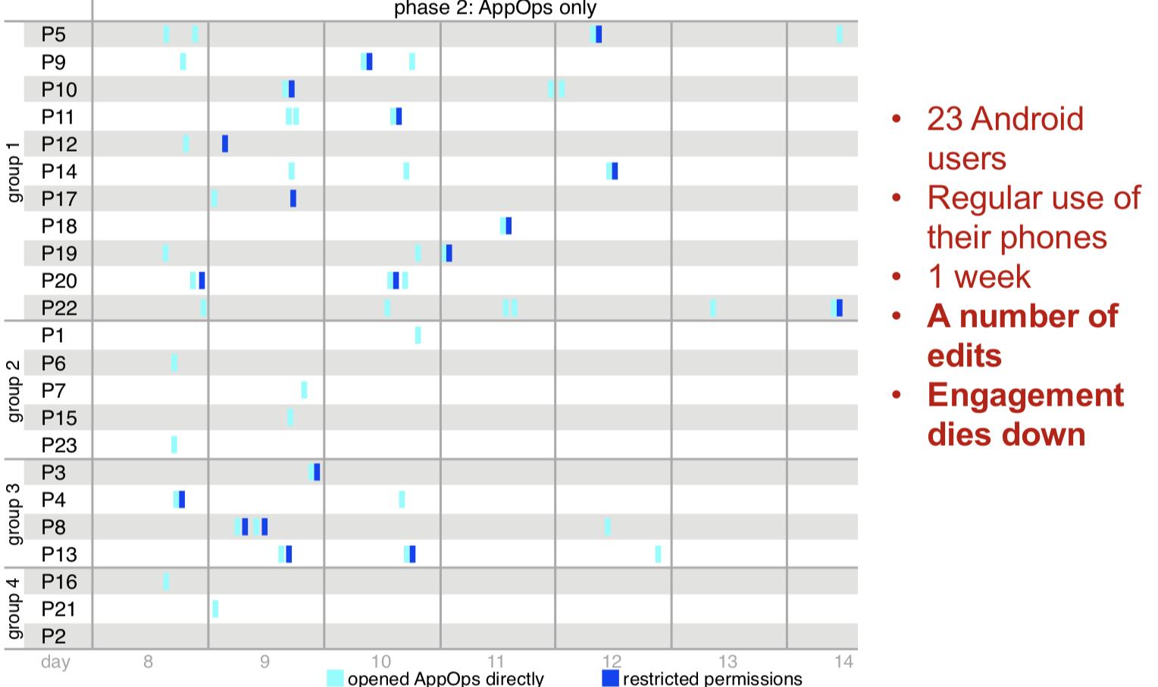
How often do users check permissions?

Slide 7
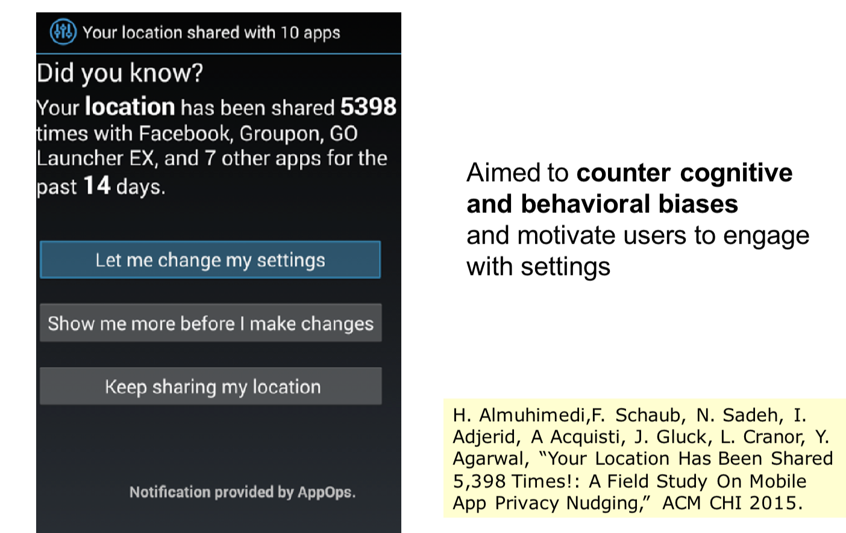
What if we nudge them a bit?

Slide 8
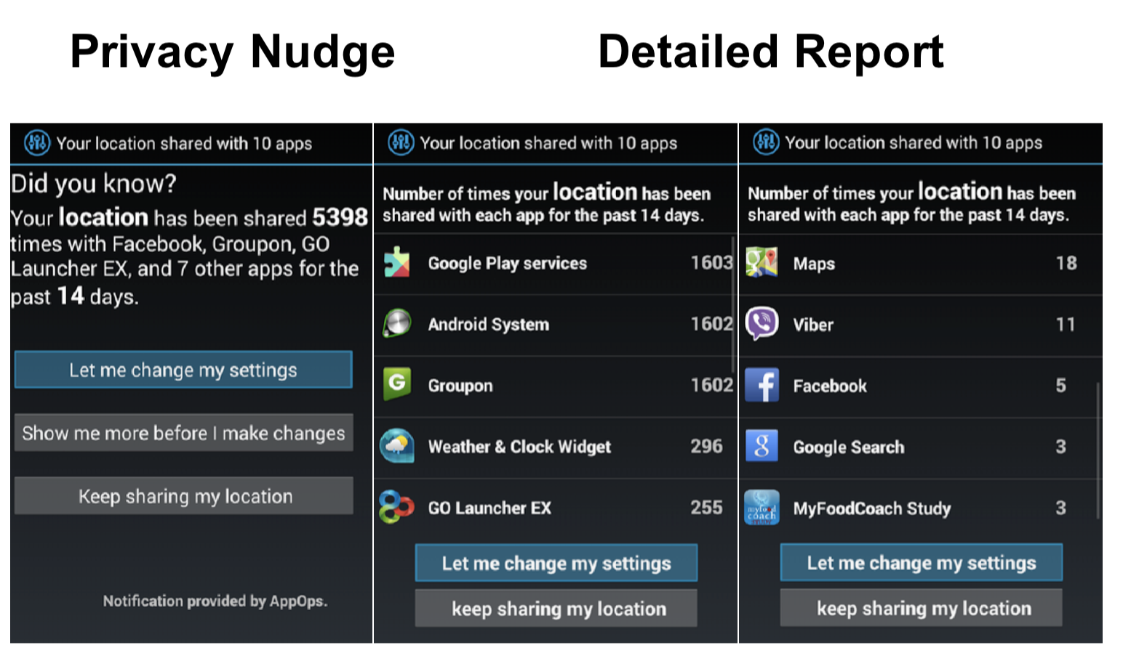
Nudge design

Slide 9
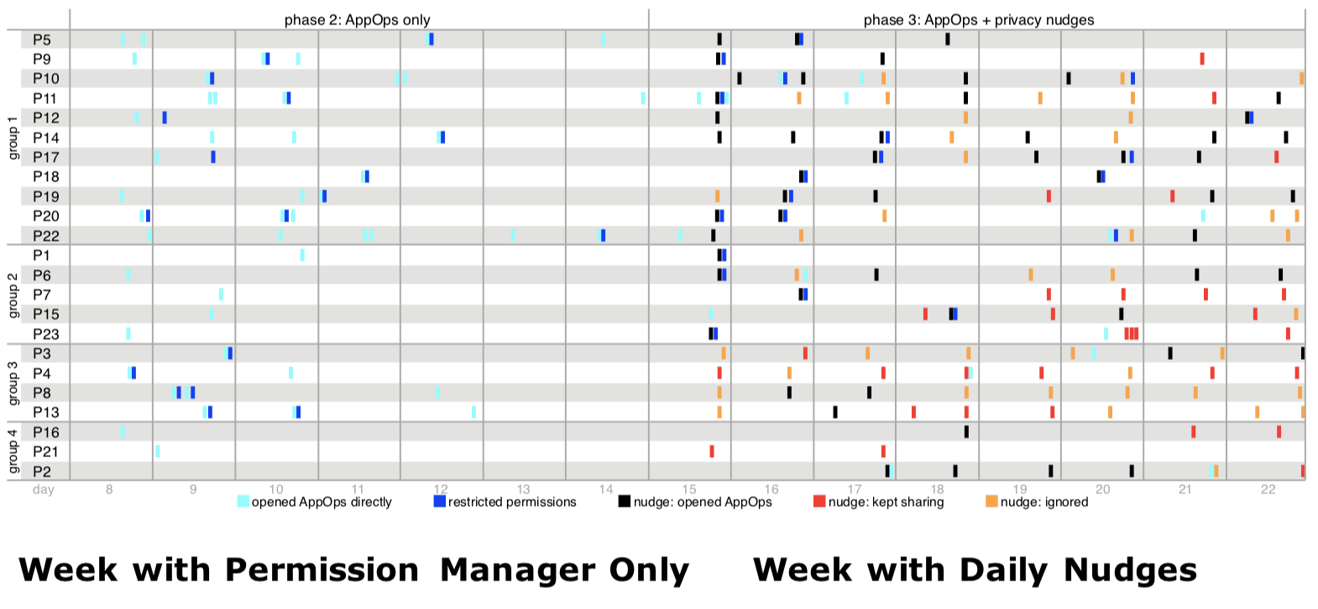
Does nudges make user change settings?

Slide 10
But how should we nudge users?
What kind of nudge?
How often?
How do we evaluate the impact? (e.g., ethics)

Slide 11
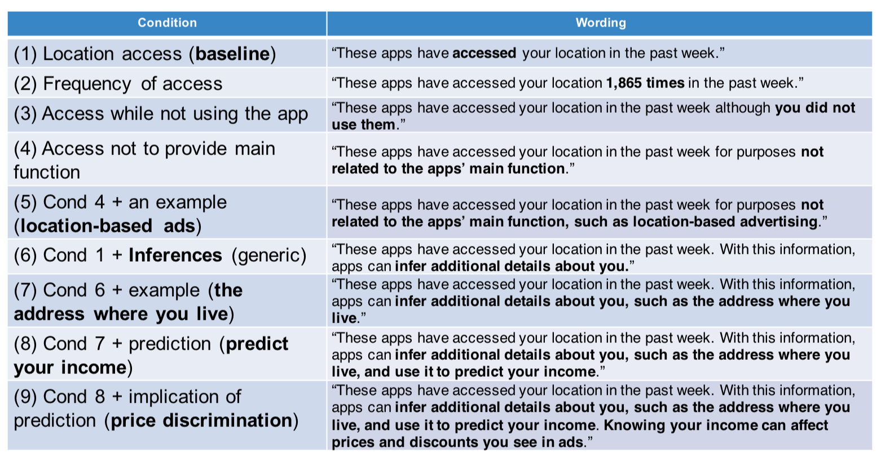
Different framing

Slide 12
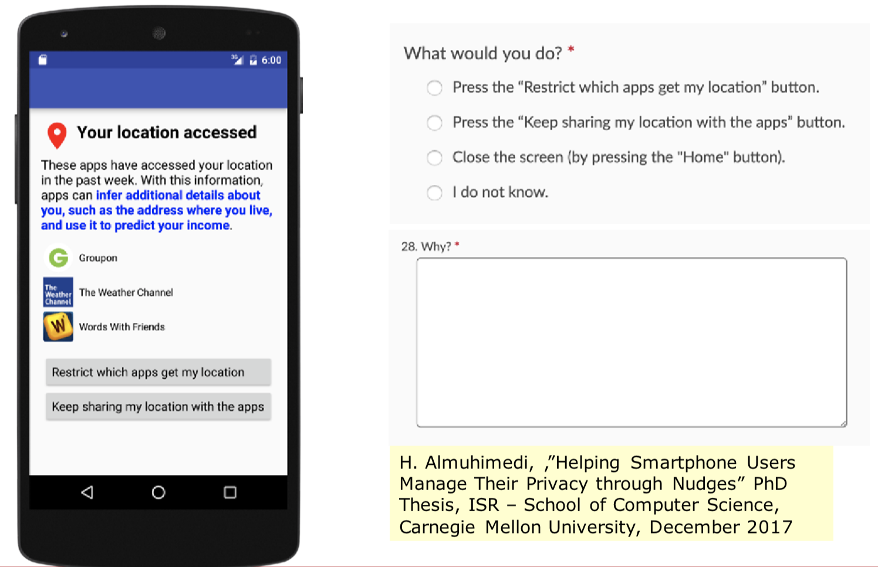
Putting it to the test

Slide 13
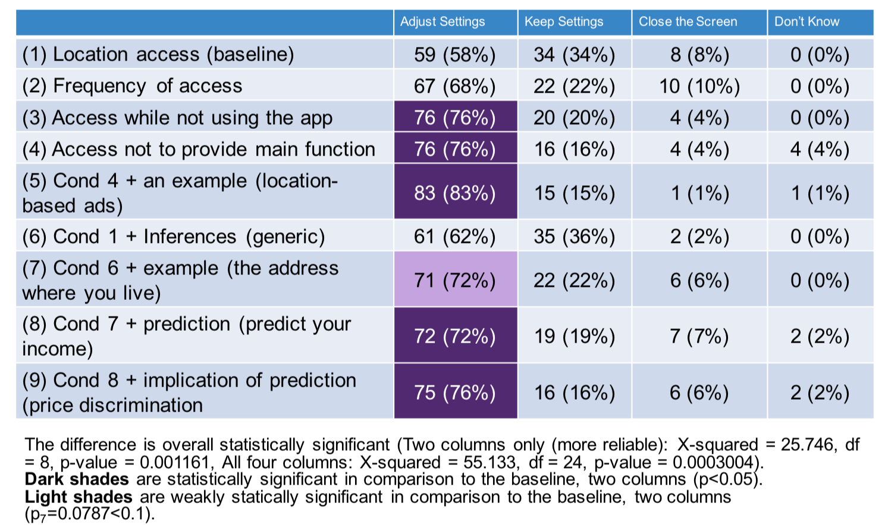
Framing matters

Slide 14
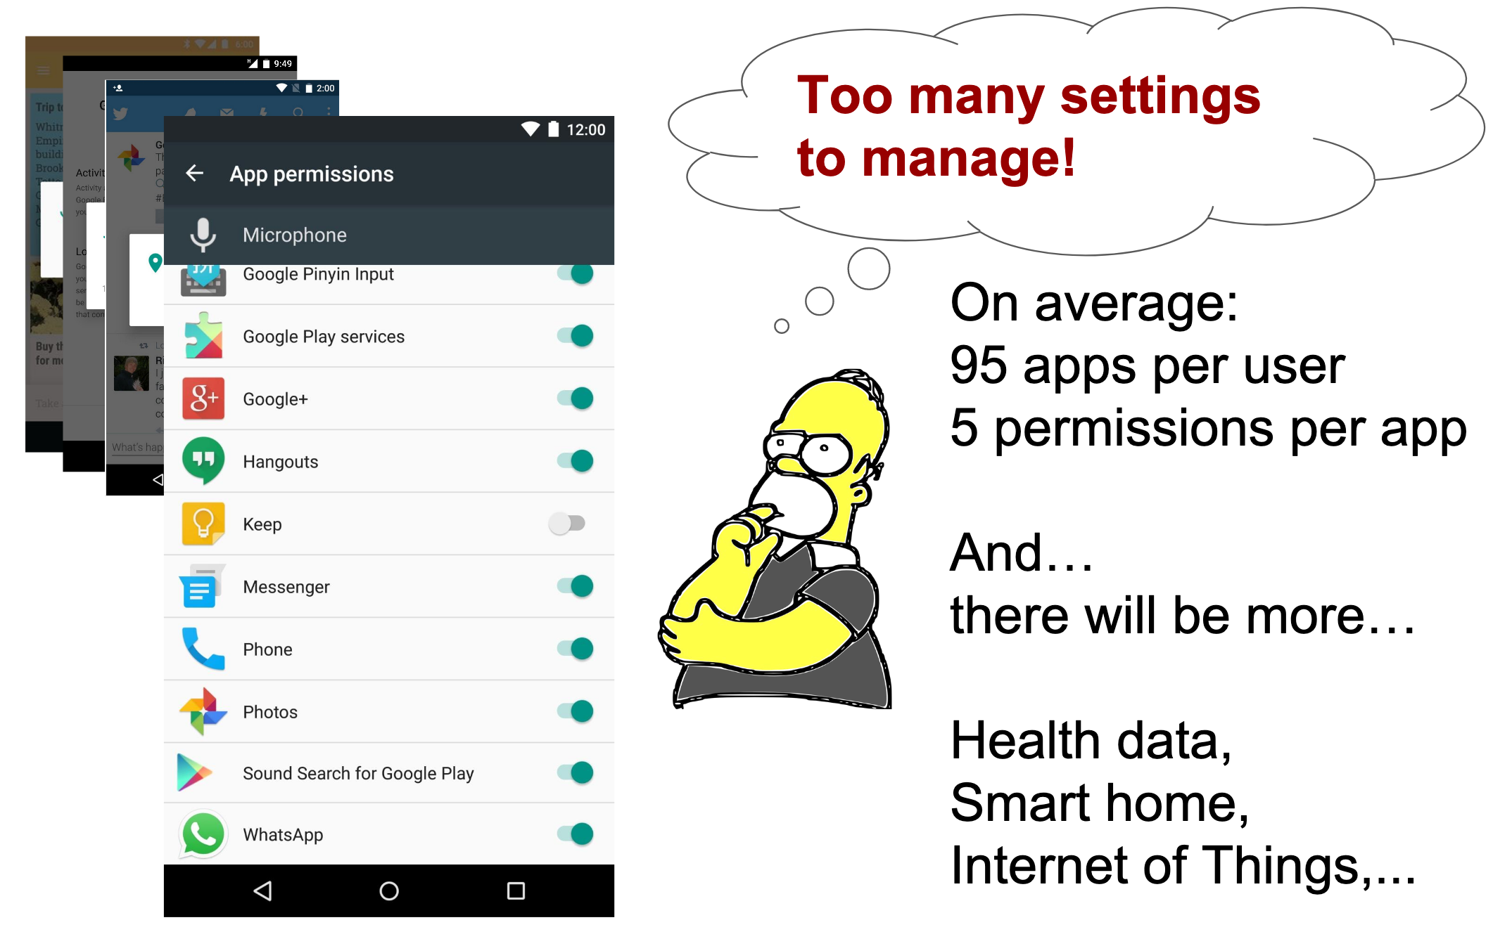
Explosion in number of privacy choices

Slide 15
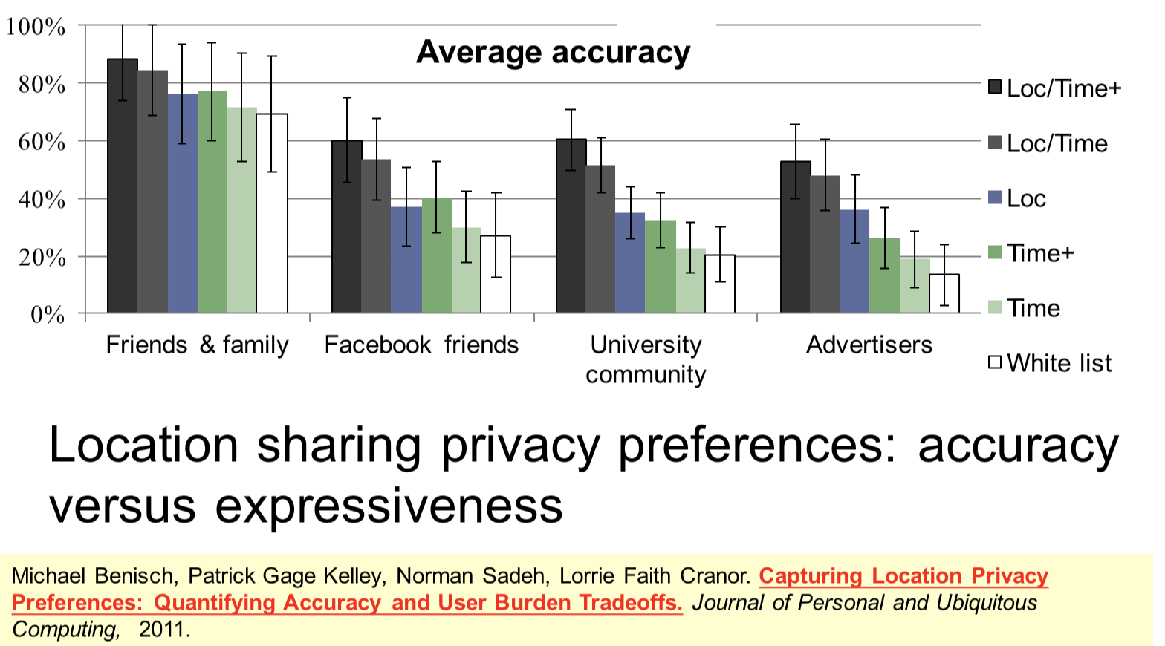
Is changing permissions scalable?
Can You Really Expect a User to Configure 100+ Mobile App Permissions?
Privacy Preferences
are Context-Sensitive Too

Slide 16
Could We Learn People’s Privacy Preferences To Help Them Configure Settings?

Slide 17
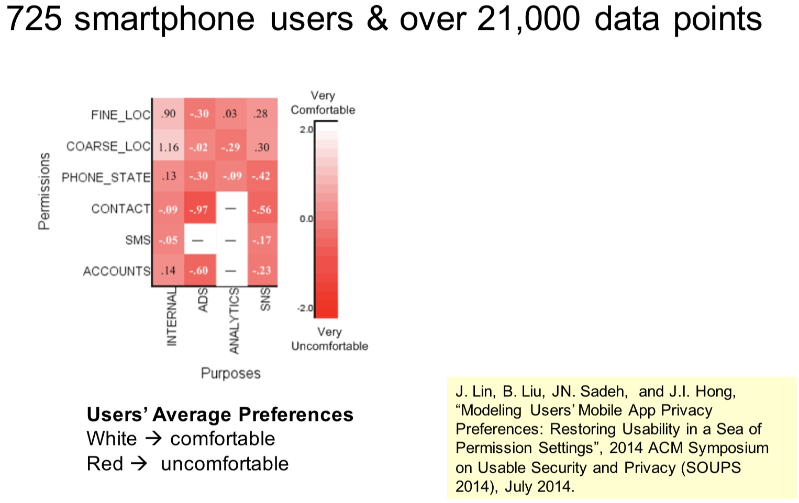
Modeling People’s Mobile App Privacy Preferences

Slide 18
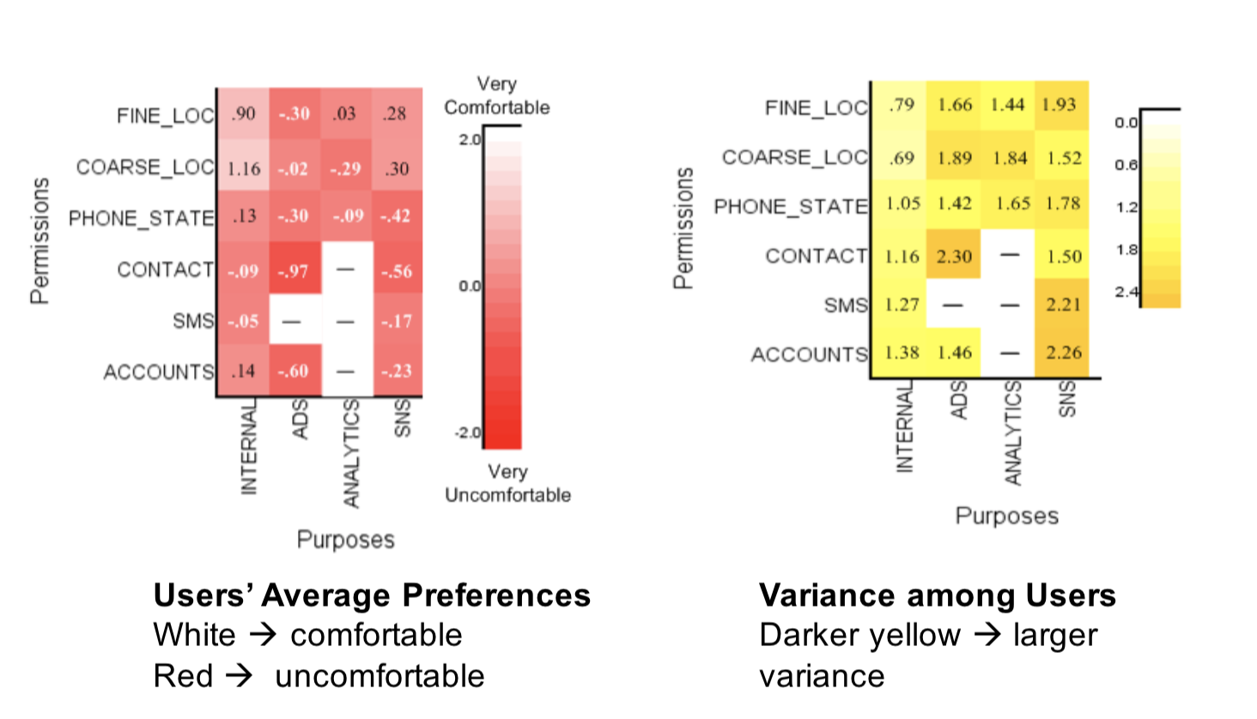
One Size-Fits-All Defaults Don’t Work

Slide 19
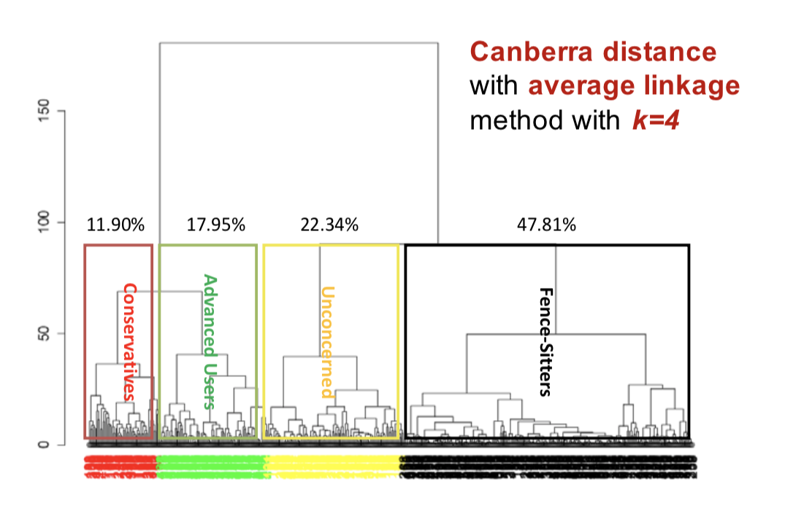
Hierarchical Clustering

Slide 20
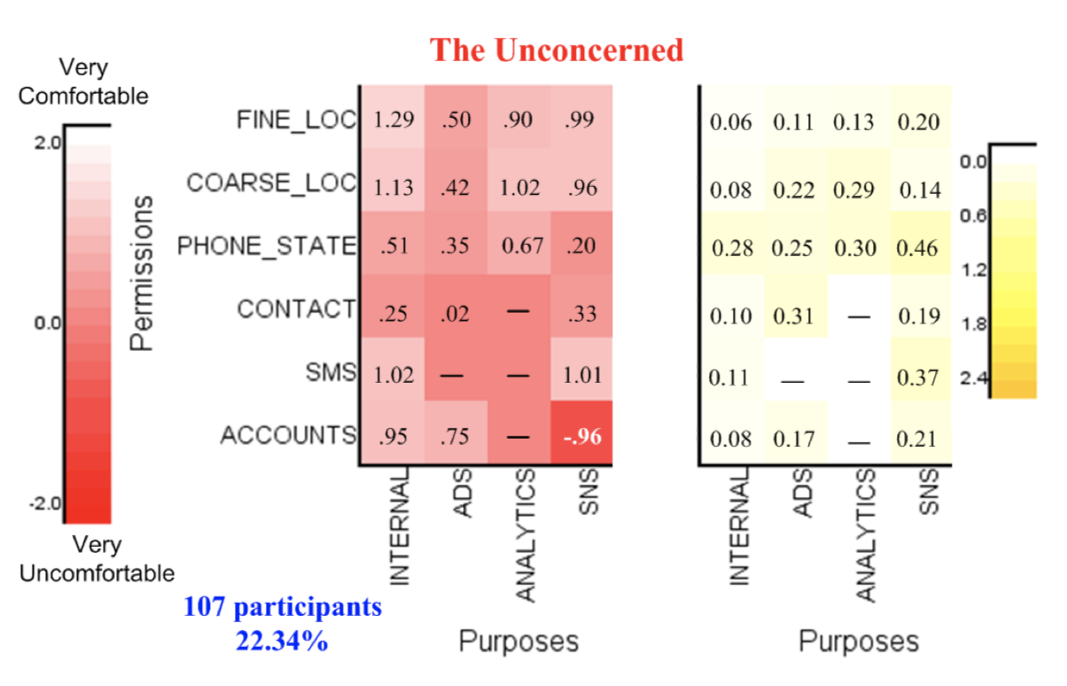
Unconcerned group
Generally open to all types of disclosures
Red in SNS/Accounts is probably a fluke – insufficient data

Slide 21
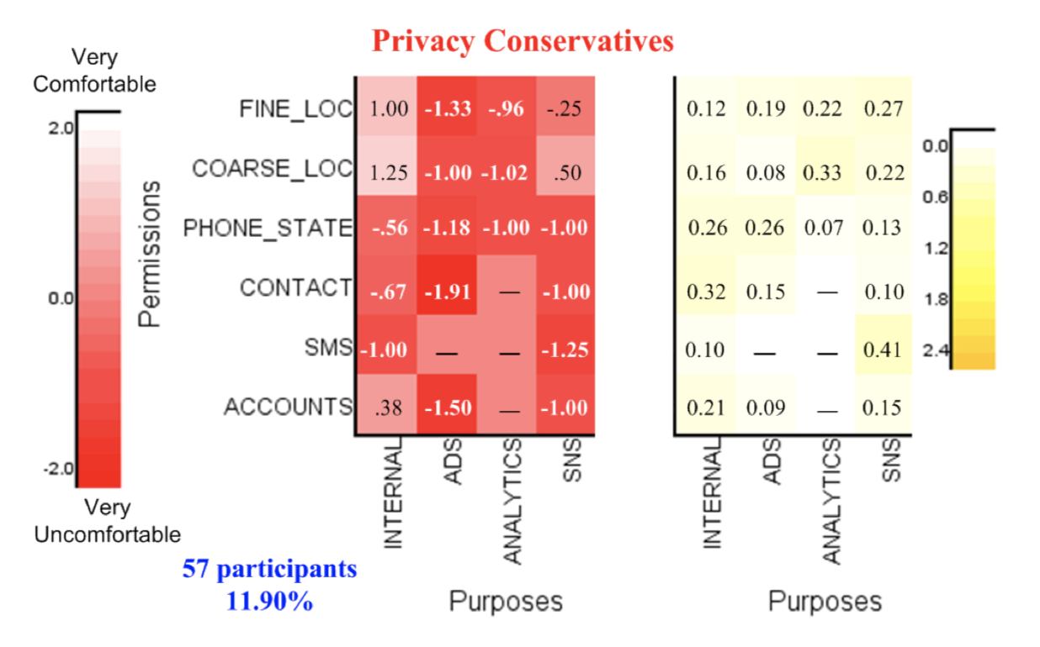
Conservative Cluster
Uncomfortable letting external libraries access their information in general
Even for internal purposes in the case of contact list, SMS and phone state

Slide 22
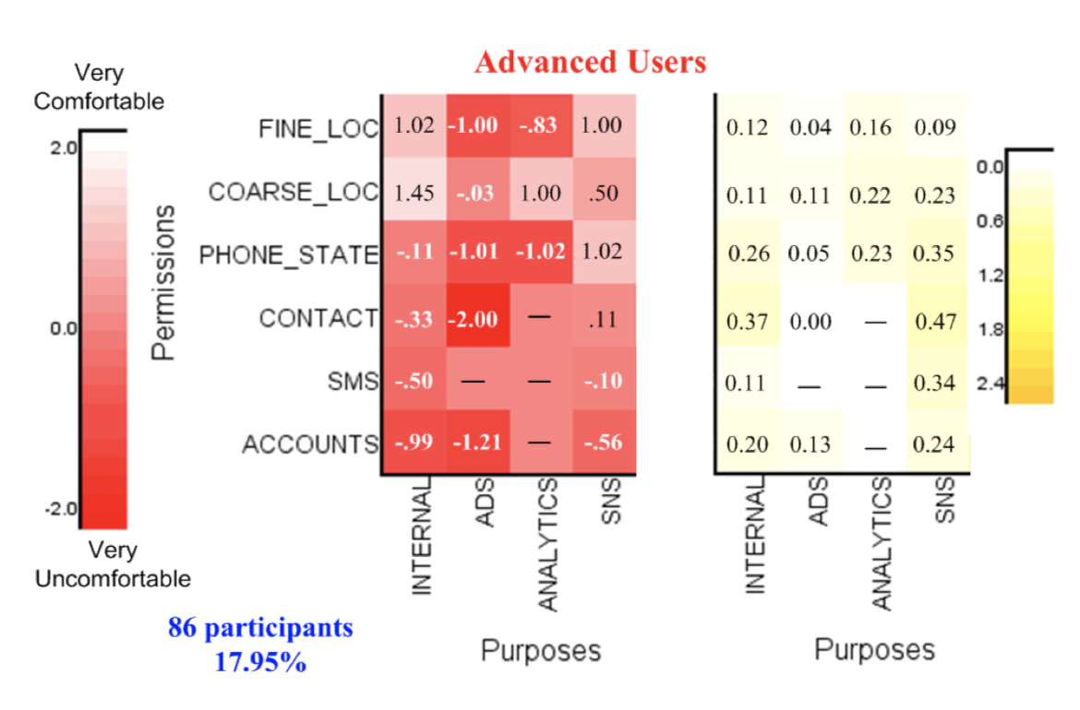
Advanced User Cluster
Appear to be conservative too, but more selective
Don’t like ads and mobile analytics
OK disclosing coarse location information, more cautious with fine location
OK disclosing fine location with SNS

Slide 23
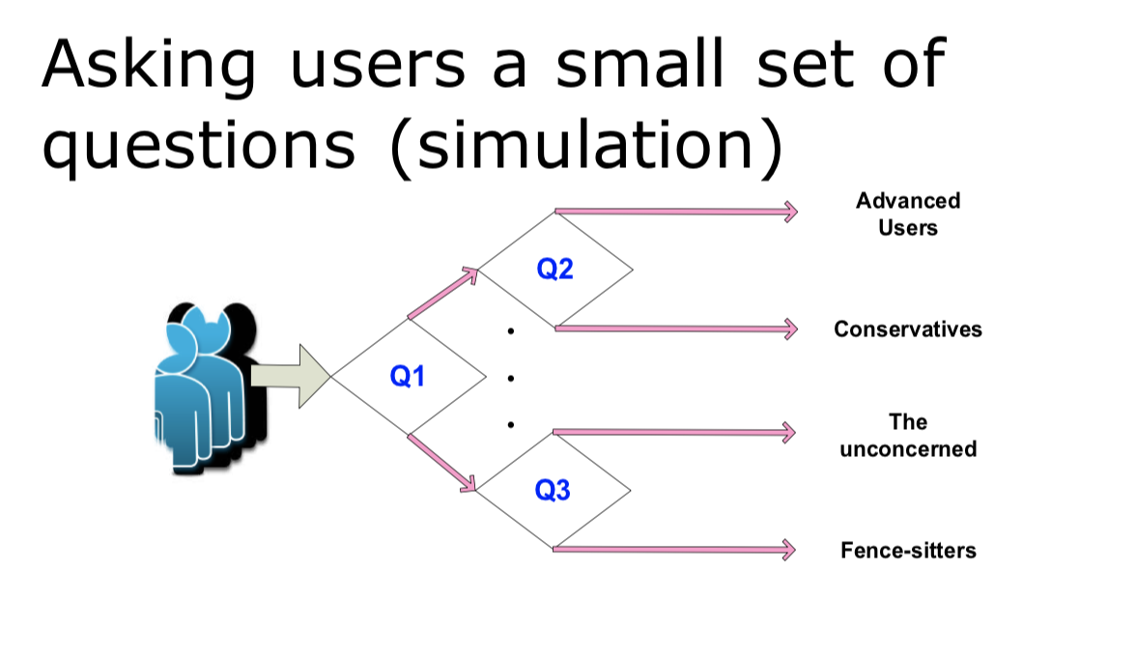
Identifying a User’s Privacy Profile

Slide 24
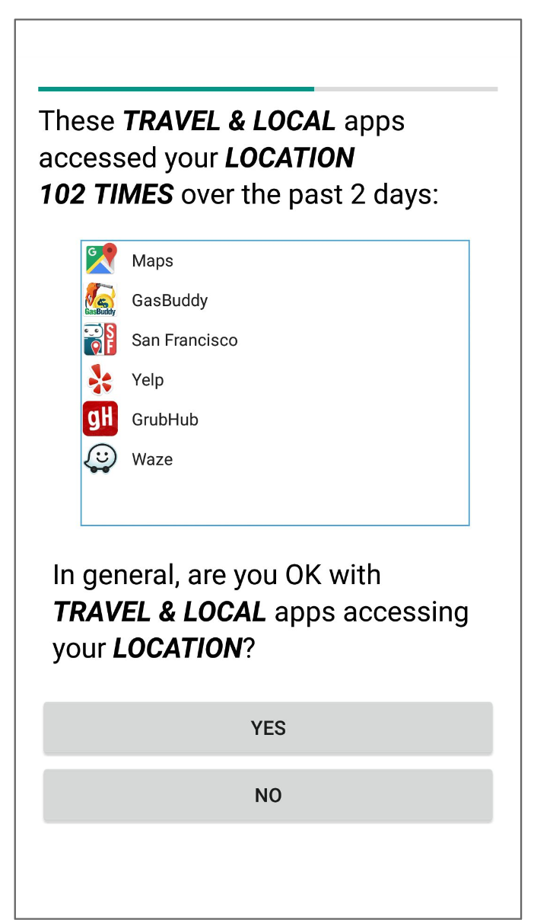
Generating Profile-based Recommendations for Users
For each new user, the privacy assistant app asks up to 5 questions to capture the user’s preference.
Types of questions:
(category, permission)
(permission, purpose)
(permission)
Context-specific: the questions are chosen by optimizing a decision tree dynamically according to what apps are installed on users’ device.

Slide 25
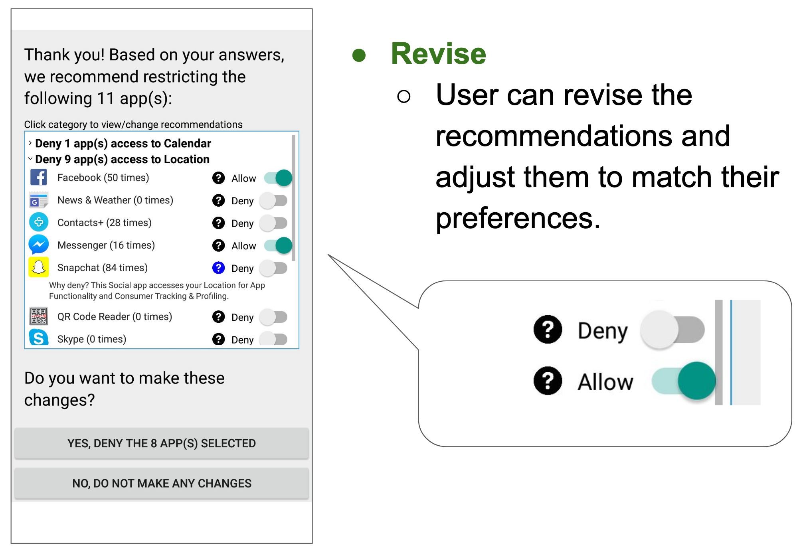
Showing recommendation

Slide 26
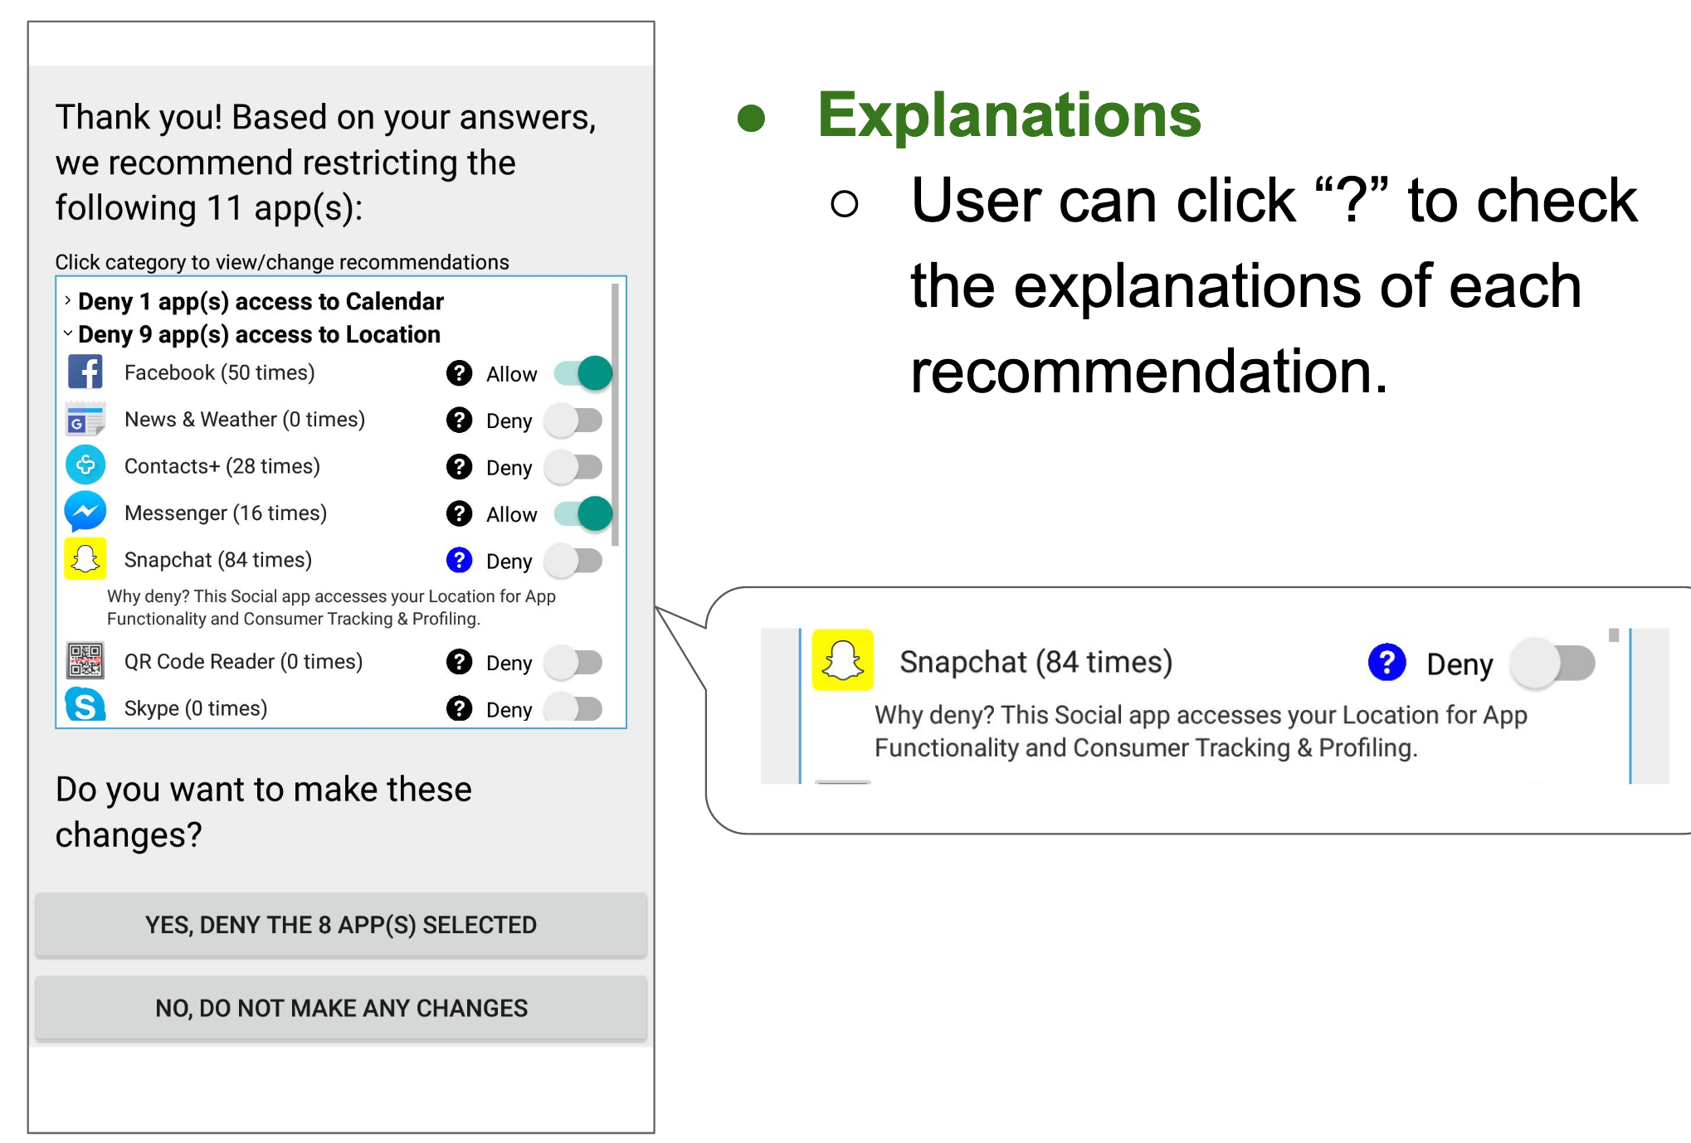
Recommendation with explanation

Slide 27
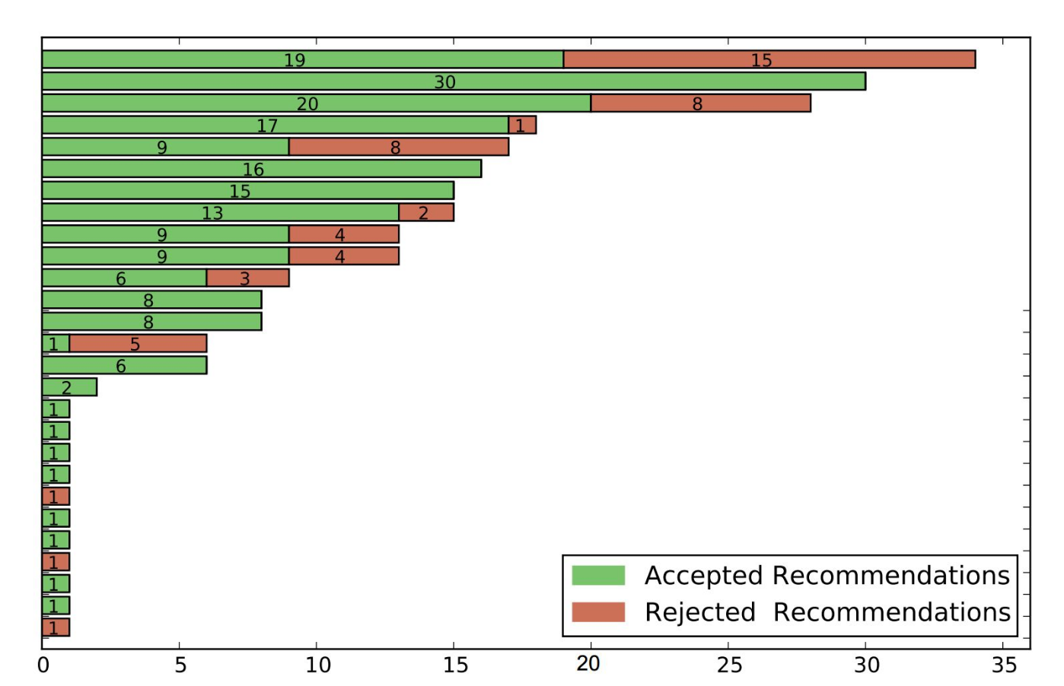
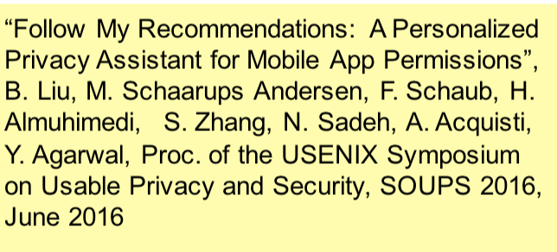
Field test
27 participants are shown recommendations
Majority of the recommendations were accepted
196 of 249 recommended items (78.7%)

Slide 28
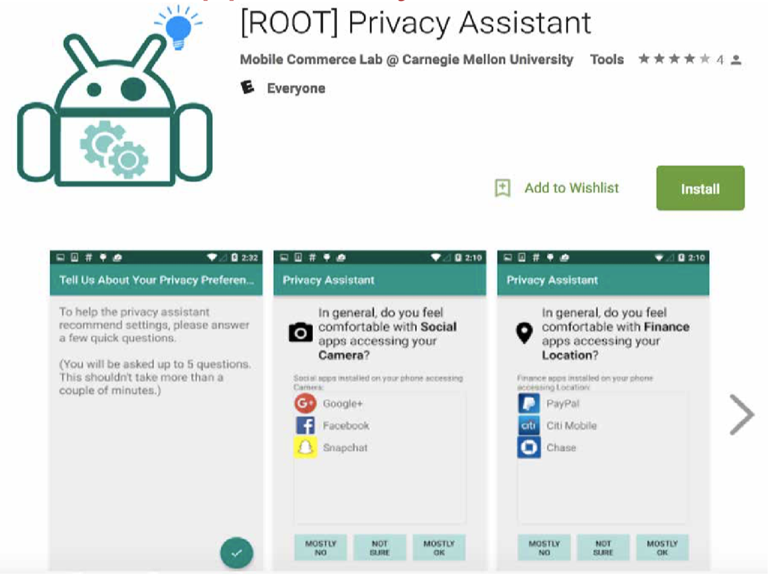
Mobile App Privacy Assistant

Slide 29
What about IoT settings?
• No App Stores • No (standardized) UI • Often hidden, embedded • More ways of collecting personal data • Explosion in number of devices & services(scale)
Different settings:
In smart homes
In smart surroundings

Slide 30
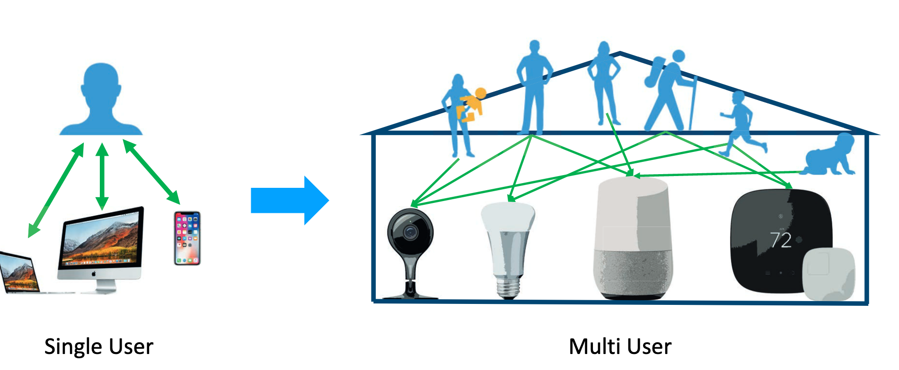
From single user to multiple users

Slide 31
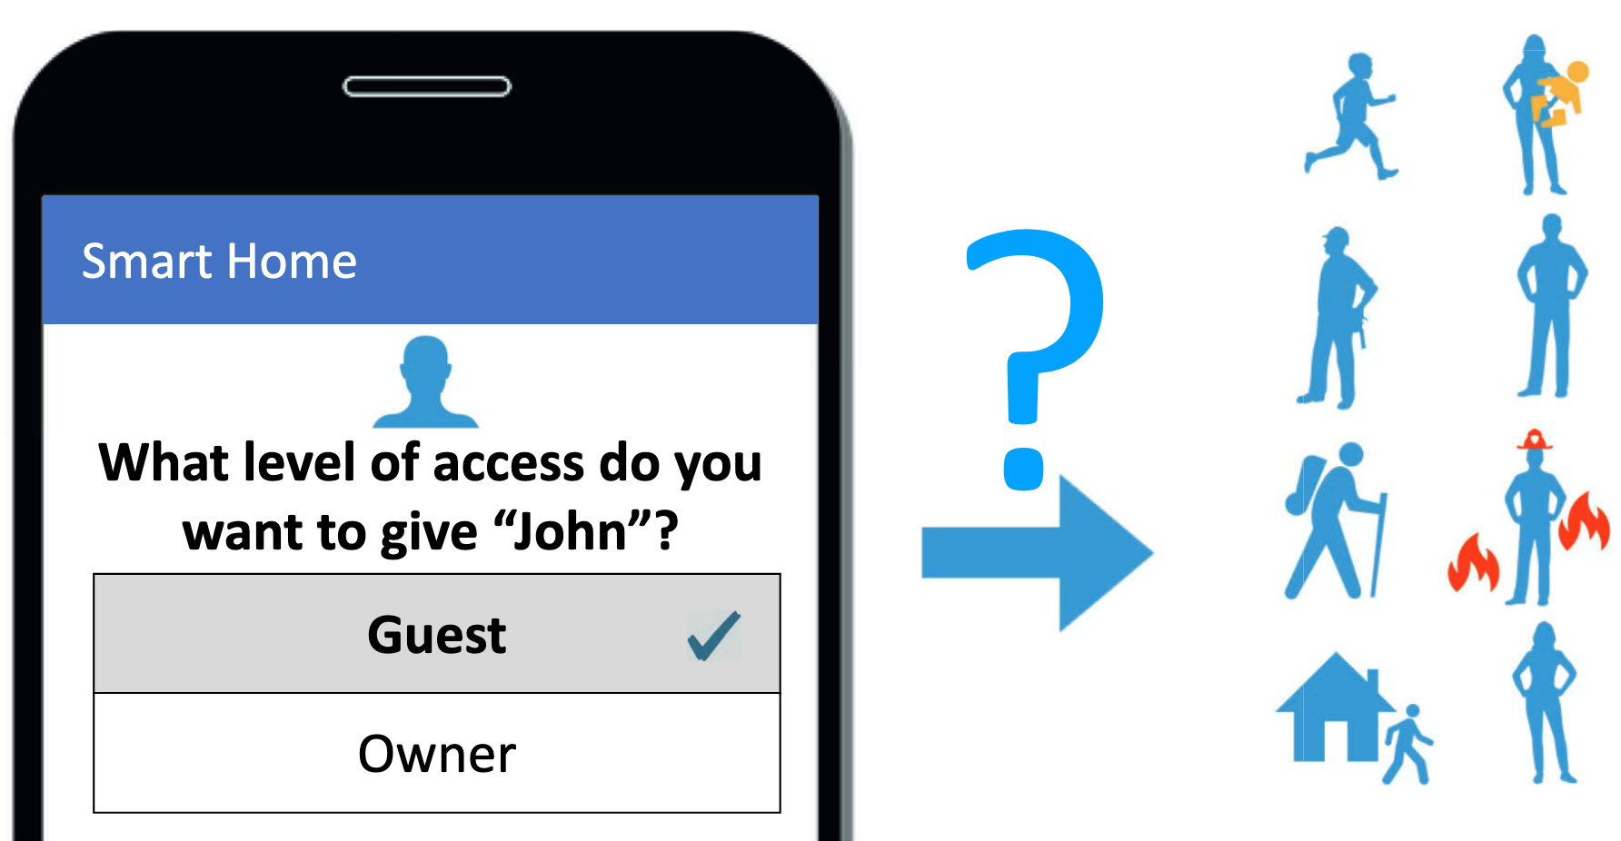
Access controls for different users

Slide 32
Determining privacy settings for IoT
Map desired access-control policies for IoT devices
How policies might vary by relationship and capabilities?
Identify potential default policies
What contextual factors affect decision?
W. He, M. Golla, R. Padhi, J. Ofek, M. Du ̈rmuth, E. Fernandes, and B. Ur, “Rethinking access control and authentication for the home Internet of Things (IoT),” in 27th USENIX Security Symposium (USENIX Security). USENIX Association, 2018, pp. 255–272.

Slide 33
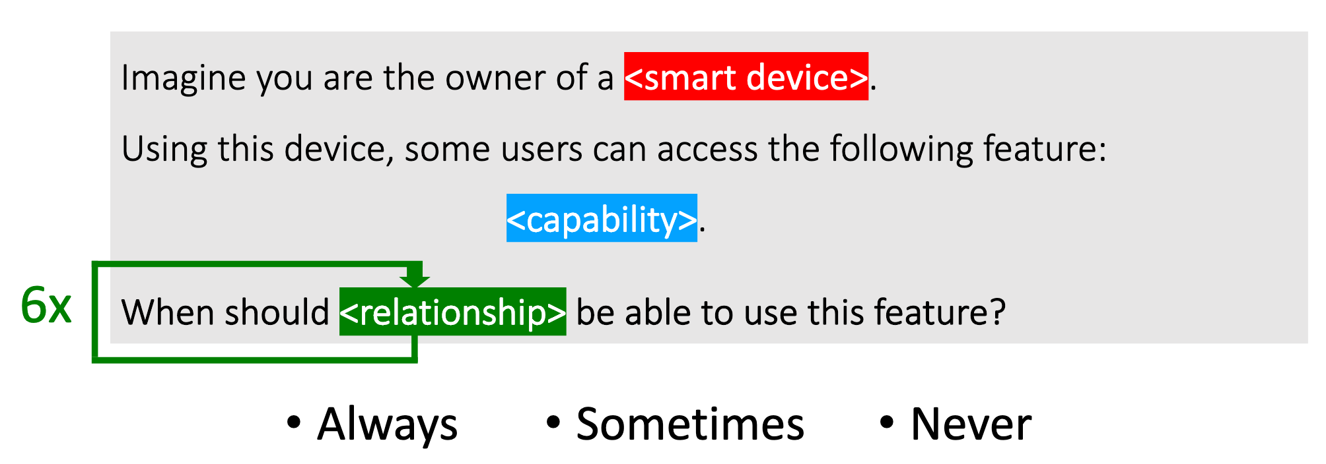
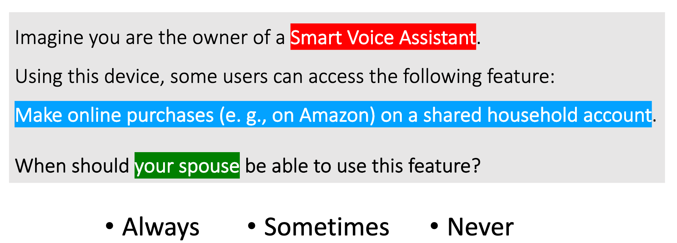
User study design
Template
Example

Slide 34
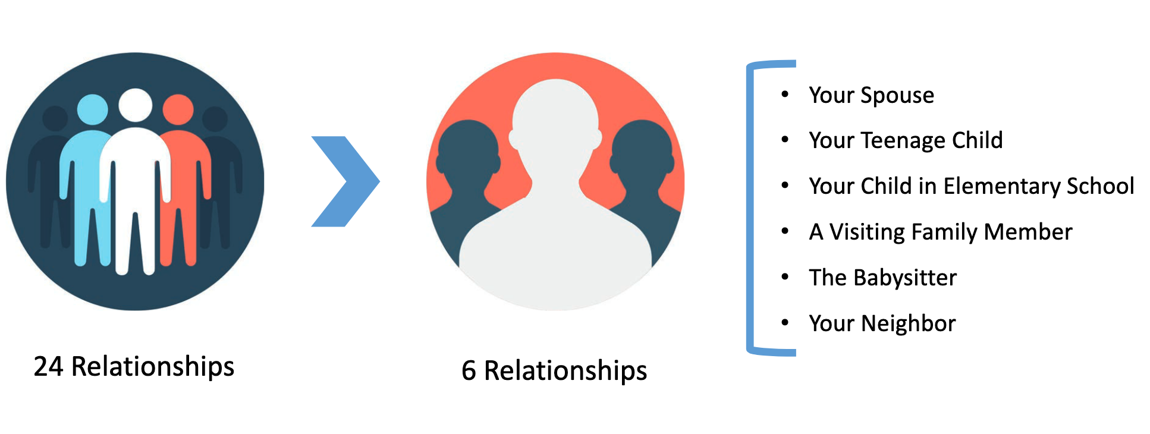
Relationships considered

Slide 35
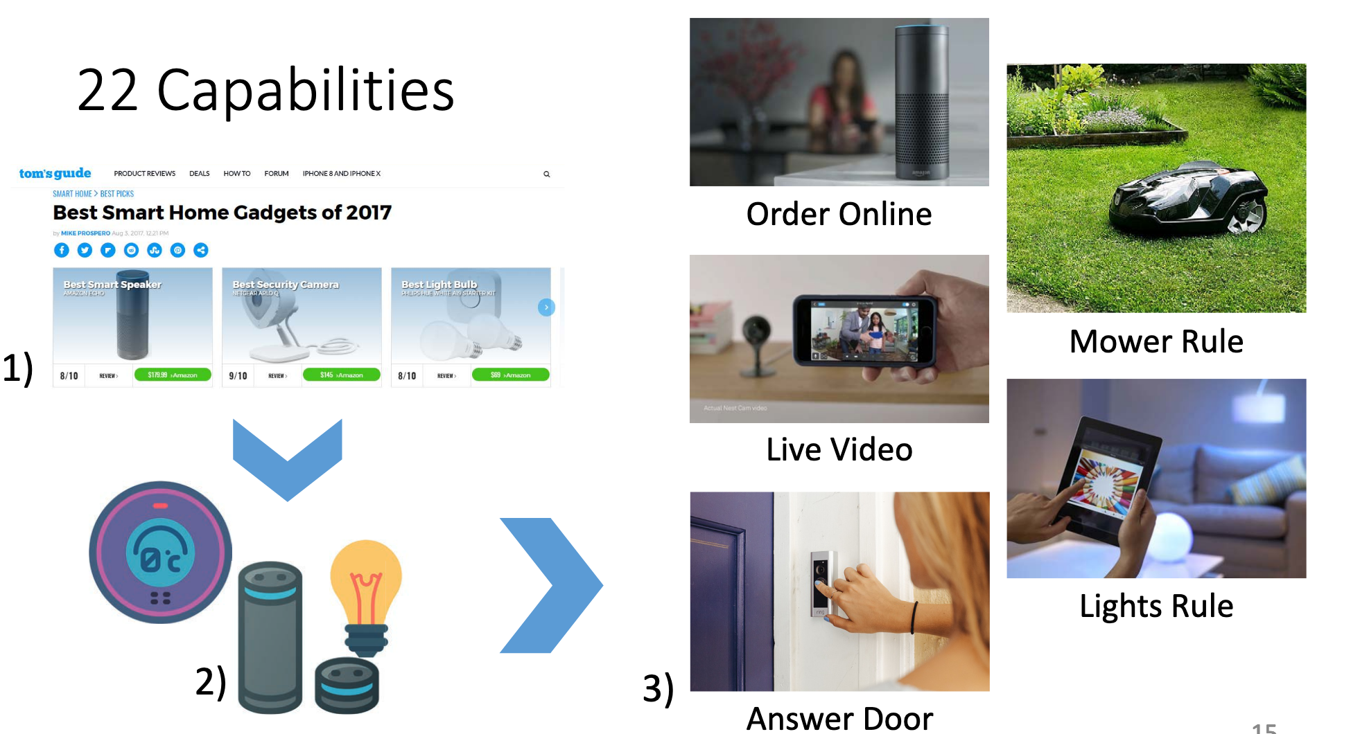
Capabilities

Slide 36
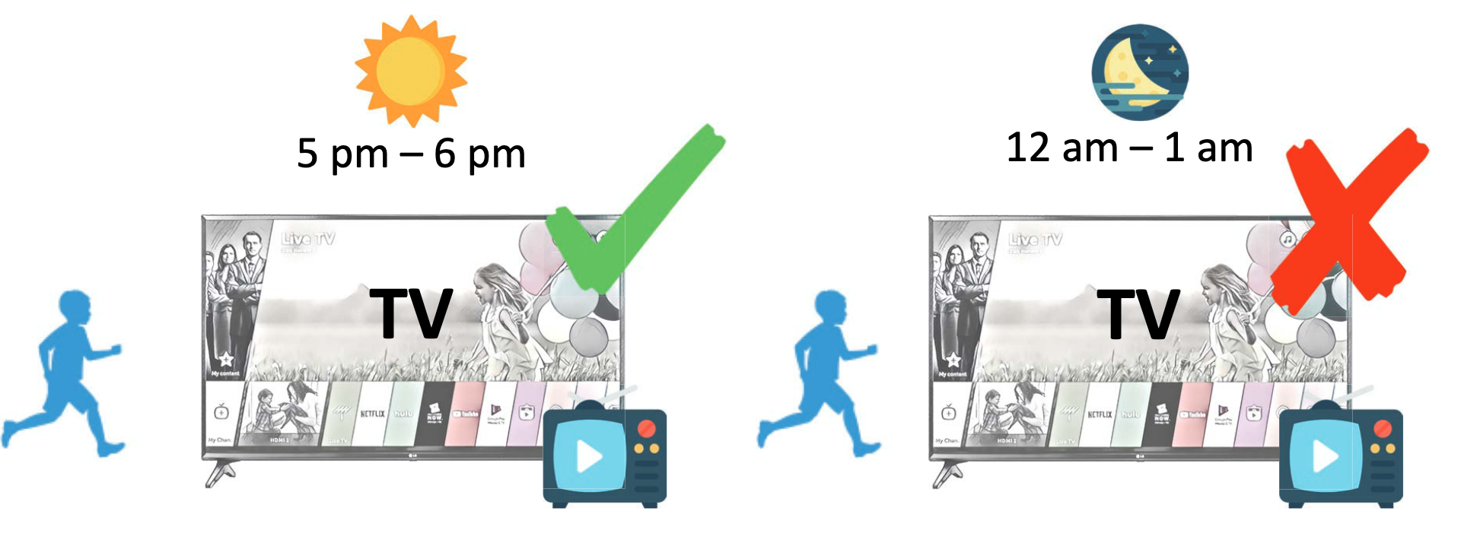
Are relationship and capabilities enough?
Temporal factor

Slide 37
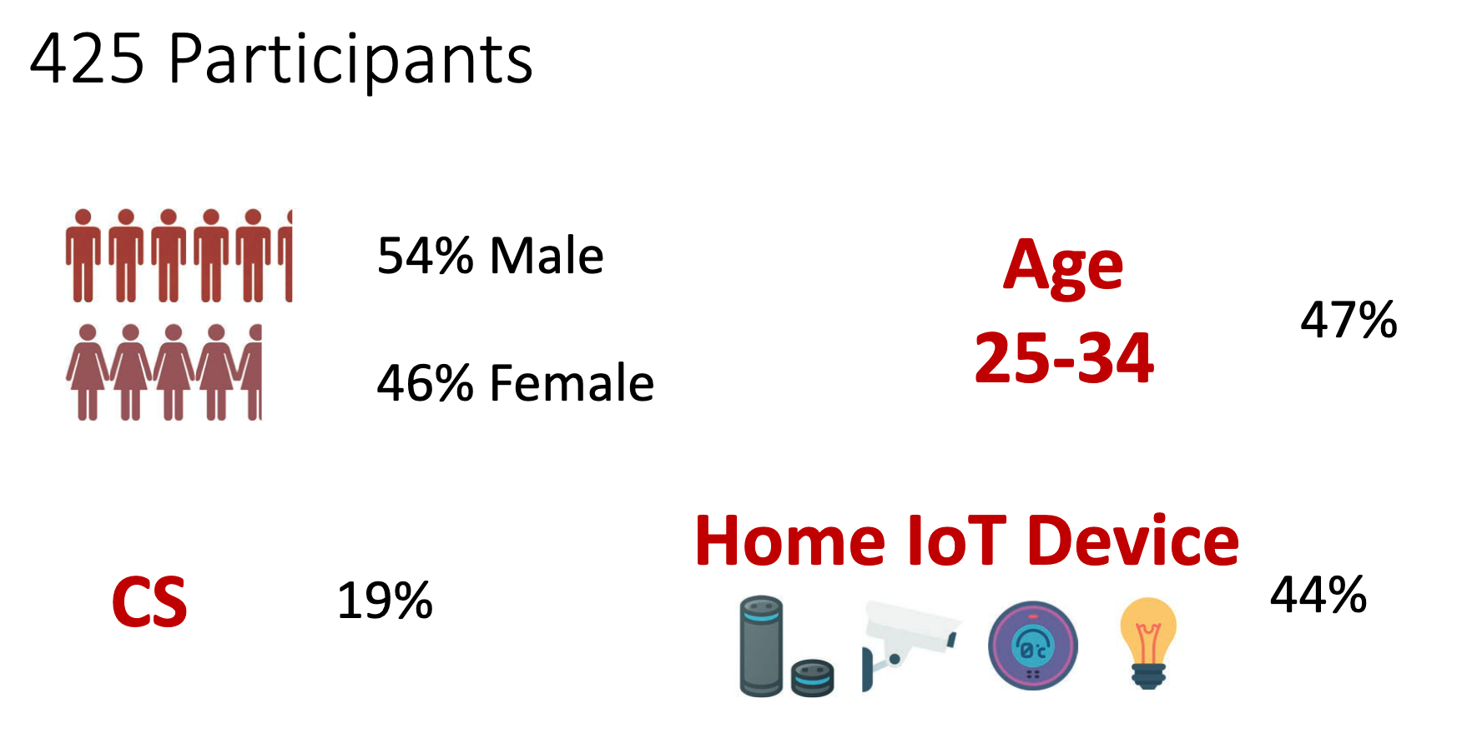
Participants (MTurk)

Slide 38
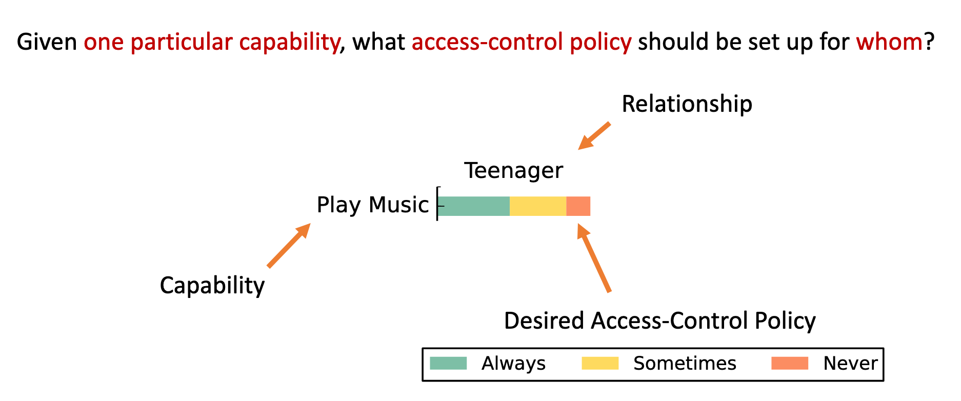
Question format

Slide 39
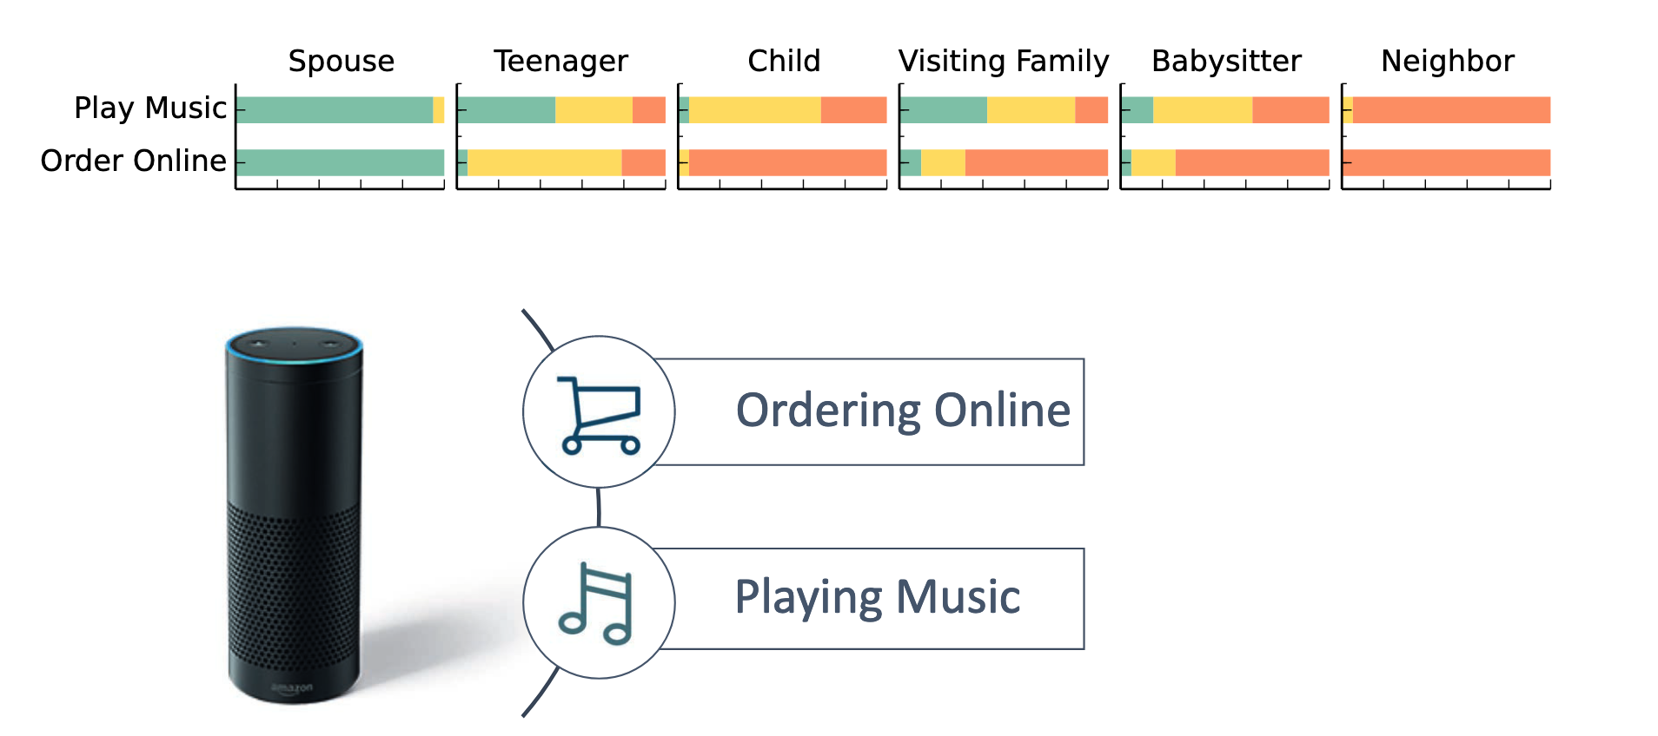
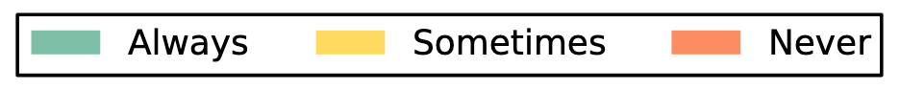
Comparison between capabilities

Slide 40
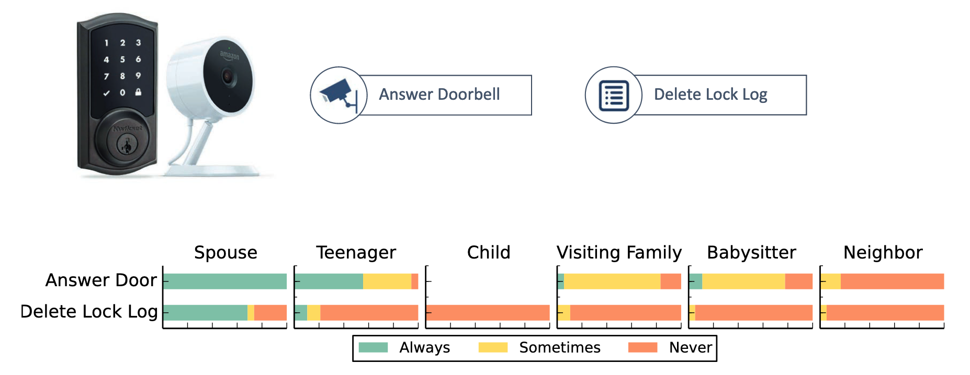
Capabilities of certain devices

Slide 41
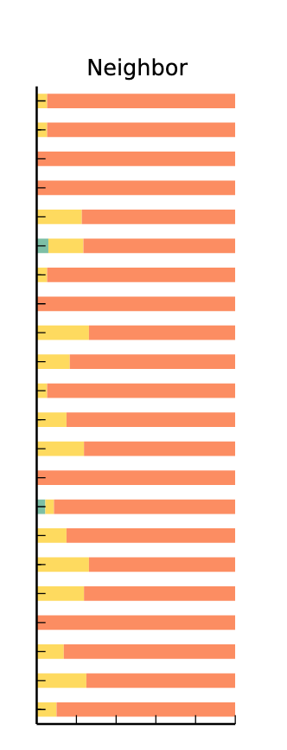
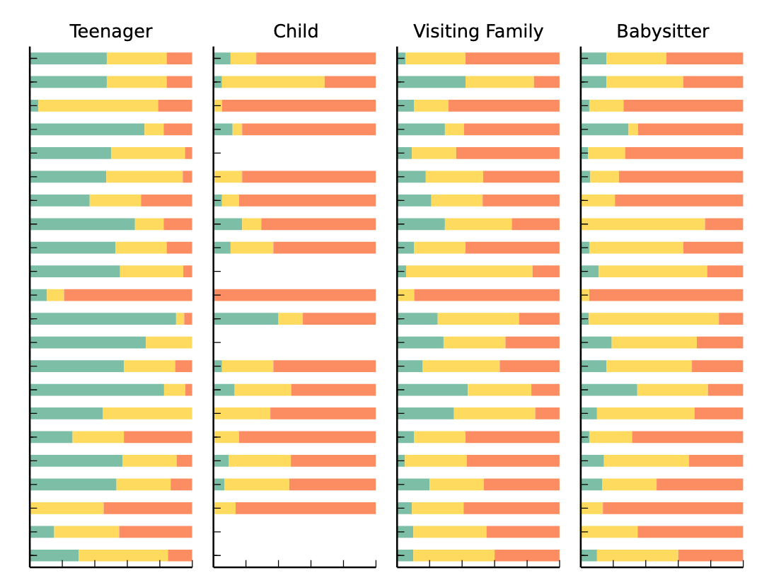
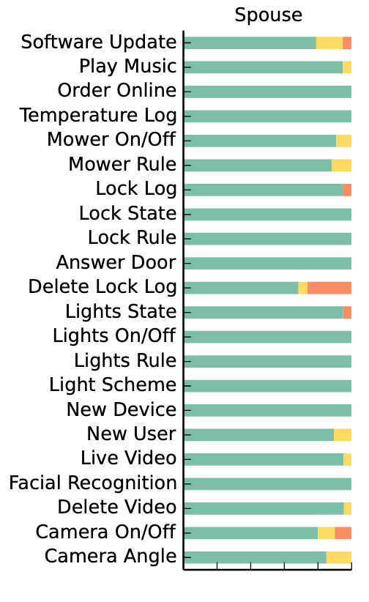
Capabilities across relationships
Spouse
neighbor

Slide 42
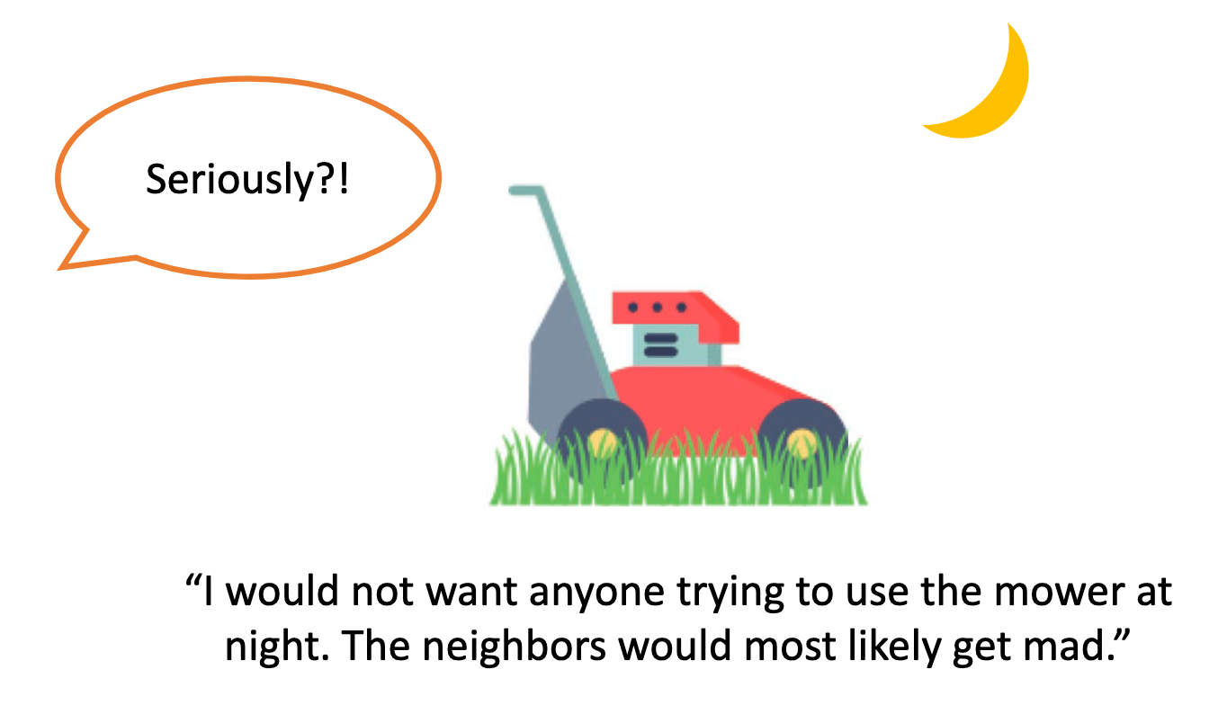
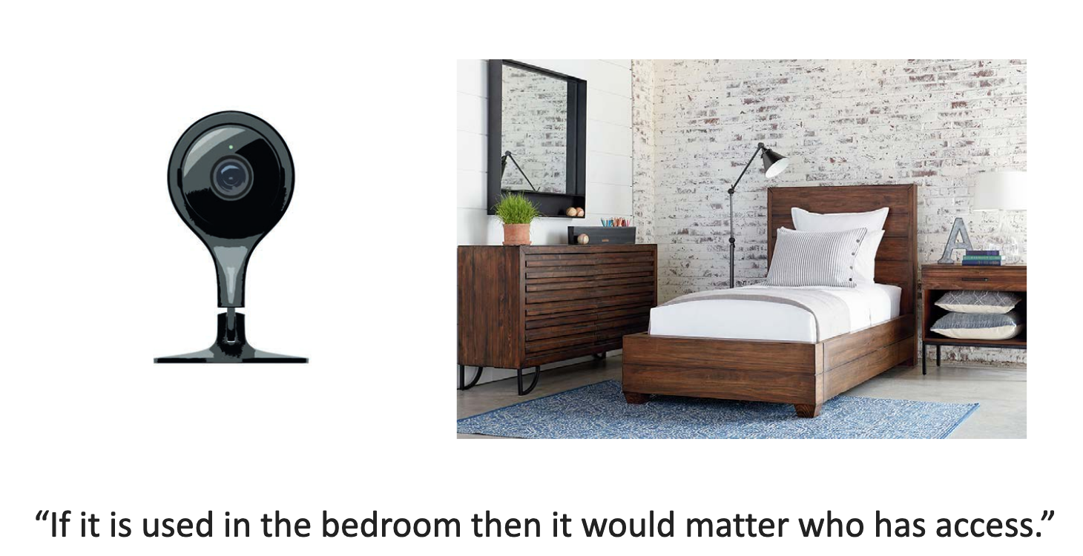
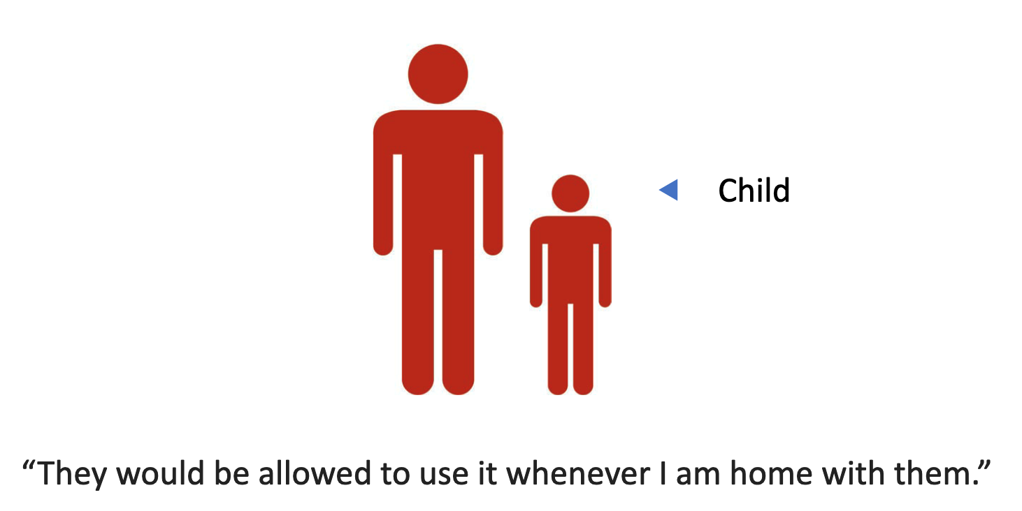
Contextual factors
Relationship matters but not always sufficient
Need to understand the context to better construct access control policies
Time of day
Location of device
Others nearby

Slide 43
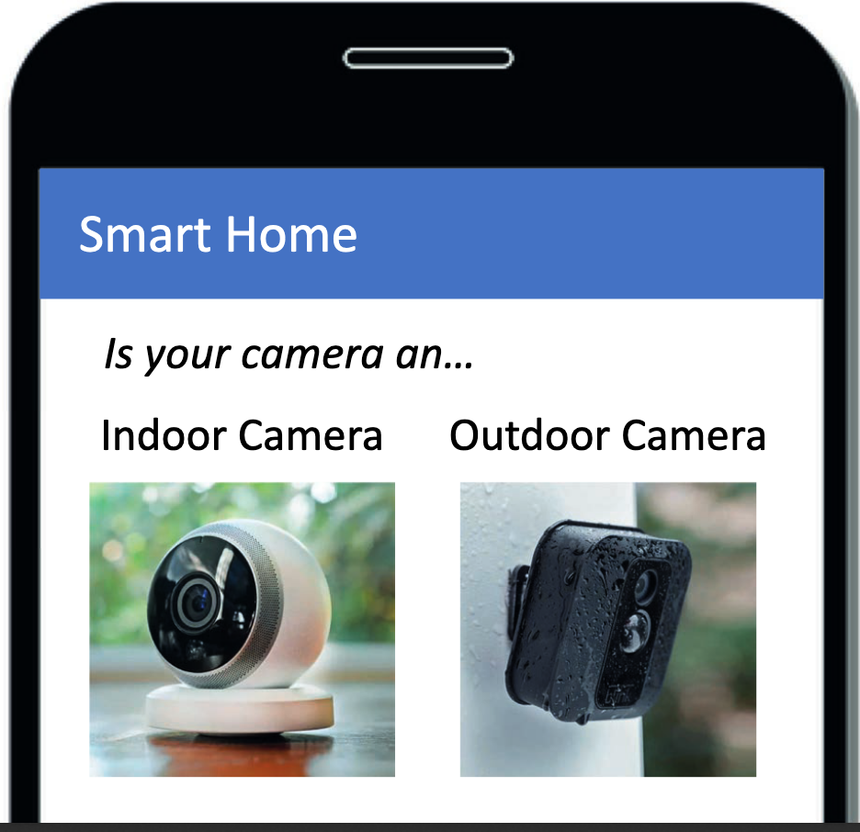
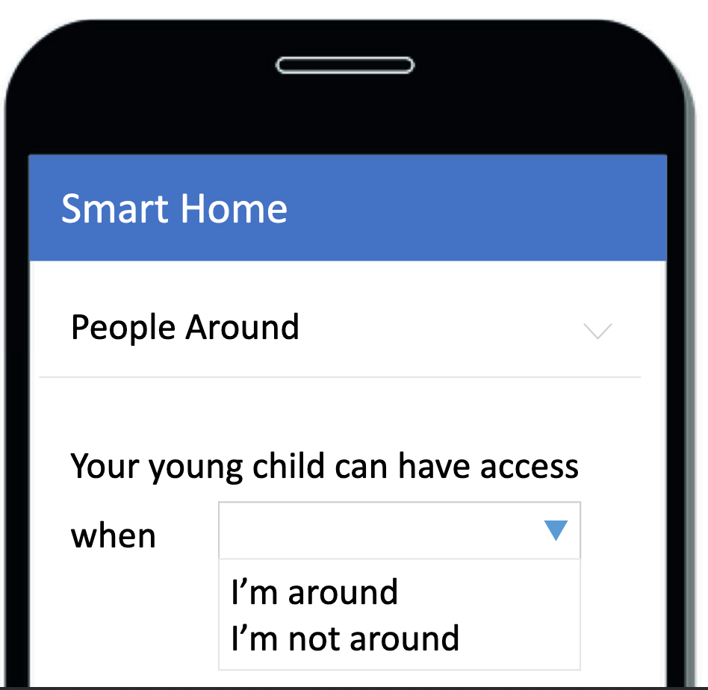
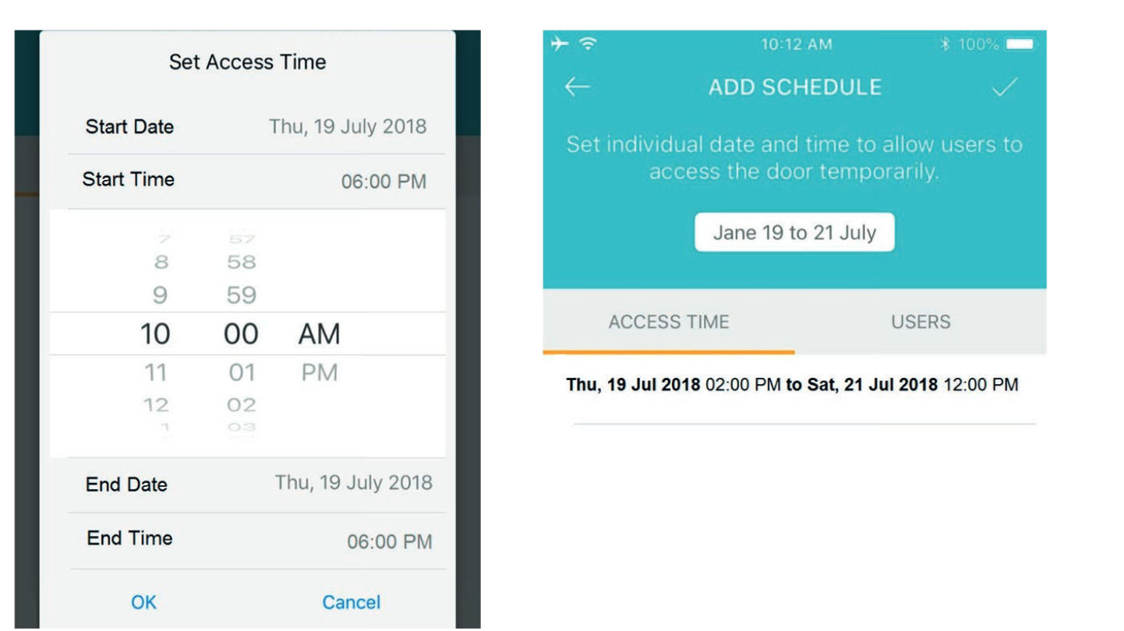
Designing access control
Issues:
Quickly blows up again
Need a better way to help users make and configure this choices

Slide 44
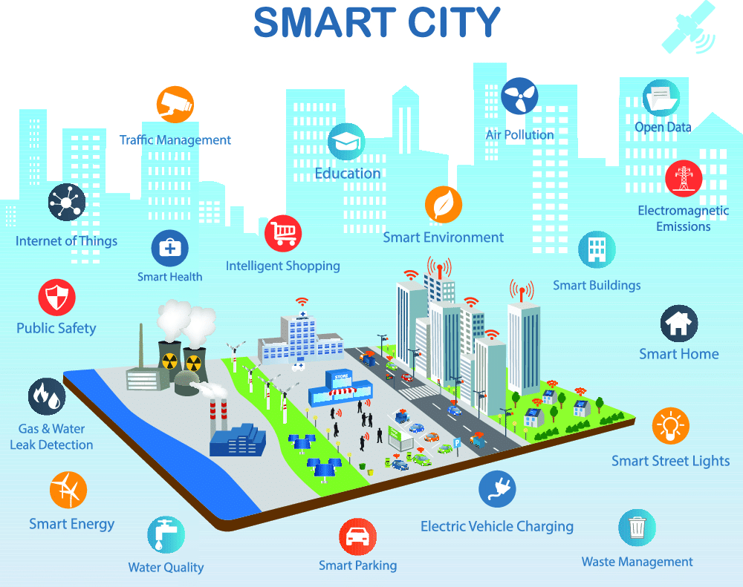
Privacy preference in smart cities
Smart buildings
Smart shopping
Smart parking

Slide 45
Design questions
Informing people about data collections
What should we notify people about?
Giving some choices to control privacy
What factors make people comfortable?
What factors make people allow/deny a data collection?
Making the system automated
How well can we predict people preferences?
P. E. Naeini, S. Bhagavatula, H. Habib, M. Degeling, L. Bauer, L. F. Cranor, and N. Sadeh, “Privacy expectations and preferences in an IoT world,” in Thirteenth Symposium on Usable Privacy and Security (SOUPS ). USENIX Association, 2017, pp. 399–412
Notes:
To build the system we need to have more information about people privacy preferences. This system has 3 main components. First is to notify people about nearby IoT data collections without overwhelming them. For that we need to study what people want to be notify about. The second component is giving choices to people to control their privacy. To enable this we should know what factors of a data collection make people comfortable or uncomfortable. Suppose we know whether they're comfortable, does that mean we know whether they're willing to allow or deny collection? if it doesn't, then what factors that aren't important for understanding comfort *are* important for understanding whether data collection should be allowed or denied

Slide 46
Vignette study
Capture wide range of scenarios
Stories about individuals, situations and structures which can make reference to important points in the study of perceptions, beliefs and attitudes (Hughes 1998)
Notes:
To get answers for these questions we decided to study a wide range of IoT data collection scenarios. One approach to capture a broad spectrum of hypothetical situations is to run a vignette study.
****add a sentence to say what our vignette looks like”: In our vignette study we asked participants to imagine themselves in a number of hypothetical data collection situations.

Slide 47




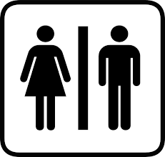




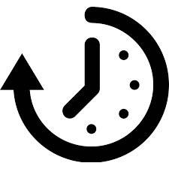




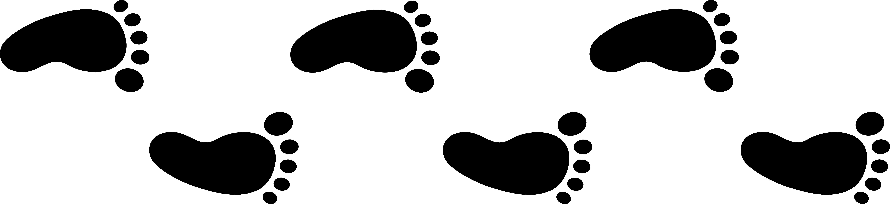
Scenarios varied by 8 factors
Type of data collected
Location of data collection
Device collecting data
Retention time
Purpose of data collection
Who benefits from data collection
Whether or not data is shared
Whether more info could be inferred
Notes:
The first factor we included in the scenarios is the type of data including video, audio, and biometrics (show the icons in front of each item). The second factor is location of data collection, like library, home, or public restroom. The next factor is device that is collecting the data like presence sensor, smart phone or iris scanner. The next one is retention time including week, year, forever. Next factor is whether or not the purpose of data collection was mentioned in the scenario. The factor is who benefits from the data collection and this could be the data collector or the user. The next factor is whether or not the data is shared and the last factor is whether or not addition information could be inferred from the collected data.
****shared: 1) law enforcement 2) device manufacturer

Slide 48
Example scenario
You are at [work]. This building has [cameras] that are recording [video of the entire building]. The video is [shared with law enforcement] to [improve public safety] and they [will not delete it].
Notes:
We had 2 types of scenarios. The first type are the ones that are more common and participants have likely already experienced them like: [read the 1st scenario]

Slide 49
Example scenario
You are at a [department store]. This store has an [iris scanner] that scans customers' irises automatically as they enter the store in order to [remotely identify returning customers]. Your iris scan will be kept for [one week].
Notes:
The second type are the scenarios that may not be common now but will be in the near future. Like: [read the 2nd scenario].

Slide 50
Studied 380 IoT scenarios
126,720 possible scenarios
Eliminate infeasible scenarios
14 scenarios for each participant
1007 Mechanical Turk participants
From the United States
Avg. age: 35.3
~15 minutes to complete
Notes:
We had 8 factors per scenario and this leads us to have one hundred and twenty thousand different scenarios. However not all of these combinations made sense. For example an iris scanner collecting finger print was can not be a valid scenario. Thus we removed the scenarios that didn’t make sense and ended up having 380 scenarios. The minimum number of scenarios that can cover all the levels of all the factors was 14 so we provided each participant with 14 scenarios.

Slide 51
Questions per scenario
I would want my mobile phone to notify me [every time/only the first time/every once in a while] this data collection occurs.
five point scale from “strongly agree” to “strongly disagree”
How would you feel about the data collection in the situation described above if you were given no additional information about the scenario?
five point scale from “very comfortable to “very uncomfortable”
If you had the choice, would you allow or deny this data collection?
Choices: allow, deny
Notes:
To answer our 3 main design questions we asked some question after each scenario. To be able to understand what people want to be informed about we asked them to tell us whether they agree with the following statement: [1st statement]

Slide 52
Model: Every time notification
Most impactful explanatory factor:
Biometrics for an unspecified purpose (coef: 0.88) [strong desire to be notified every time]
Presence for a not beneficial purpose (coef: -0.49) [least desire to be notified every time]
Least impactful explanatory factor:
data collected at a department store (coef: -0.69) [least desire based on this location]
Notes:
We also built the model that explains people preferences in getting notification about a data collection. In this model knowing that people biometrics is being collected for an unspecified purpose has the most effect on people desire to be notified about it every time it happens. Also knowing that their presence is being collected for a not beneficial purpose had the largest effect in making them not wanting to get notifications every time it happens. Data being collected at a department store has the least effect on notification preferences.
*****************Talk more about the least effective factor***********************
*****************Talk more about how does the output of this model help the design********************
*****************Say: here I will talk about most important factors in the models but there are a lot more in the paper.
[Don’t read the following]
Every time:
Has the highest effect on participants’ desire to be notified about a data collection: biometrics being collected for an unspecified purpose
Has the least effect on participant’s desire not to be notified about a data collection: when the data was being collected at the department store
Once in a while:
Has the highest effect on participants’ desire not to be notified about a data collection: biometrics being collected
Hast the least effect on participants'’ desire not to be notified about a data collection: presence being collected at a department store
First time:
Has the highest effect on participants’ desire not to be notified about a data collection: when participants didn’t find the data collection to be beneficial to them
Has the least effect on participants’ desire not to be notified about a data collection: when their biometric was being collected at a department store

Slide 53
Model: Comfort level
Legend:
Green: OK with
Red: No OK with
Most impactful explanatory factor:
Video collection happening today (coef= 1.39, 69%)
Biometrics (coef= -1.45, 28%)
Least impactful explanatory factor:
Data being kept forever (coef: 0.10, 48%)
Notes:
We found that people are most comfortable when their video is being collected in scenarios that are likely to happen today however when collecting people biometrics make them most uncomfortable with the data collection. Also knowing that data is being kept forever has the least effect on comfort preferences.

Slide 54
Model: Desire to Allow/Deny
Legend:
Green: OK with
Red: No OK with
Most impactful explanatory factor:
Presence collected at work (coef: 2.11, 64%)
Video collected at department store (coef: -0.9, 34%)
Least impactful explanatory factor:
Data being shared (coef: 0.52, 45%)
Notes:
What has the most effect on making people deny a data collection is when their presence is being collected at the workplace. However just knowing that the presence is being collected or the location of data collection is workplace make people allow the data collection. Also the most effective factor in making them allow a data collection is when their video is being collected at a department store. Among the factors, whether or not the data is shared has the least impact on their allow or deny choice.

Slide 55
Prediction accuracy using model
What if we ask users are about these cases directly and try to configure their preferences?
Comfort level:
~81%
Desire to allow or deny:
~79%
Notes:
As I said in the beginning, one of our goal is to develop automated tools to make decisions on behalf of users. what i talked about so far tells us what factors (for example, specific data types), are most important to users' comfort and decisions to allow or deny. now we look at whether our study results give us enough information to predict how a user would feel in a new scenario and whether she would want to allow or deny data collection.
We are able to predict people comfort preferences with an average accuracy of 81% and also their desire to allow or deny a data collection with an average accuracy of 79%.
This means our system can make decision for user when facing a new data collection scenario with 79% accuracy to for example to off the device that is collecting the data.

Slide 56
Questions
Do you see any change in perception or concern regarding IoT?
Is there hope to address all these concerns? What can we do to help users?

Slide 57
Logistics
Homework #5 due Nov. 6 @11:59pm
Project Final report due Nov 16 @11:59pm

